Slide 1


Marketing and Re-Branding Strategies
For The Upcoming Personal Care Giant ‘BU’

Slide 2

Blurb
In this presentation, we are aiming to build a holistic one year business roadmap for the upcoming personal care giant ‘BU’.
Starting with a complete market and competitor analysis, well-defined SWOT analysis and accurate STP for the brand, we’ve focused on the streamlined marketing strategies and re-branding for the same.
As mentioned in the case we’ve assumed certain particulars & disclosure of the same would be done accordingly with the flow of the presentation.

Slide 3
01
Phase 1
Phase 1 consists of the Introduction of BU and Market Analysis
02
Phase 2
Phase 2 consists of the Competitor Analysis, SWOT Analysis and STP
03
Phase 3
Phase 3 is all about Re-Branding and its highlights
04
Phase 4
Phase 4 focuses on our targets, forecasts and conclusion

Slide 4
About Us
From Home Remedy Mentor To A Global Brand
BU (literal meaning - Be You) originated in the mid 2018 as a home remedy mentor on social media platforms. Adding values to the life of unanswered people, the founders soon realized the need of a localized personal care brand that not only deals with their product but is a “Yahoo Answers” for curious people. We believe in the fact that being a personal care brand in this competitive market is a roller coaster ride but we’ve the seat belt fastened with our core belief i.e adding values to the lives of people (not only our customers, but all).
We started our entrepreneurial journey on the very first day of the year 2019 and it was a bang on start, as we had a loyal user base on social media and they trusted us. Our products were a big hit among the small customer base we had and the entire 2019 went on like this where we experimented, we achieved success, we failed a few times but we didn’t loose the knot.
Then came the most unwanted species on the earth, COVID. Due to covid wave our journey since 2020 is also wavy. But we did not sit idle in the wait of things getting back to place. We’ve planned strategies, re-branding and many more stuff to give it a fresh re-start again and this time we’re aiming big.

Slide 5
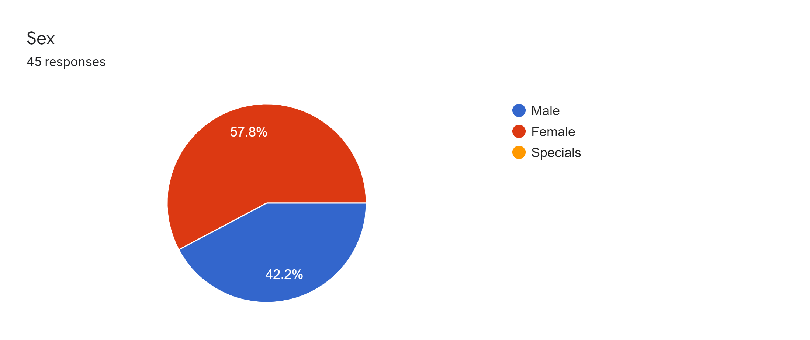
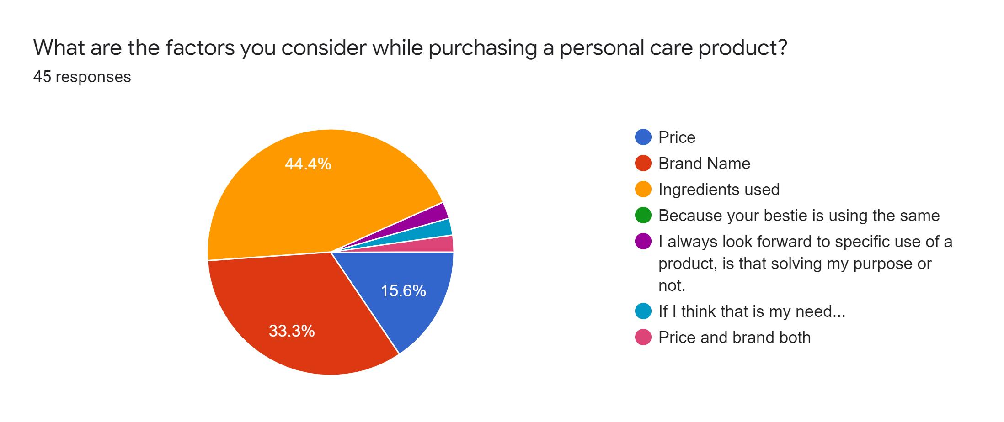
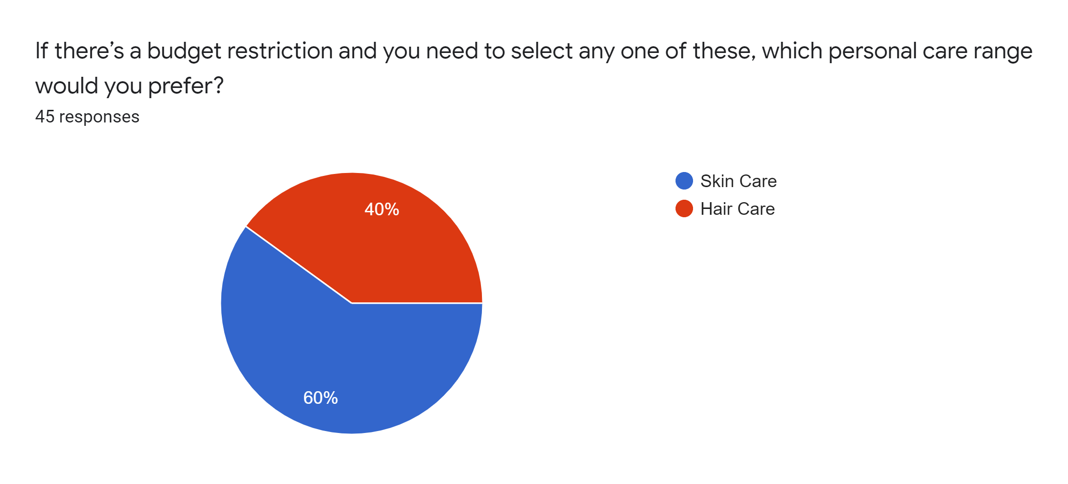
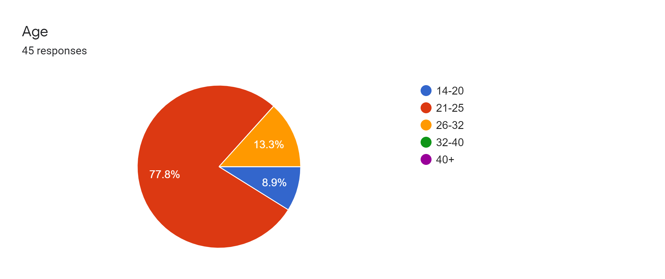
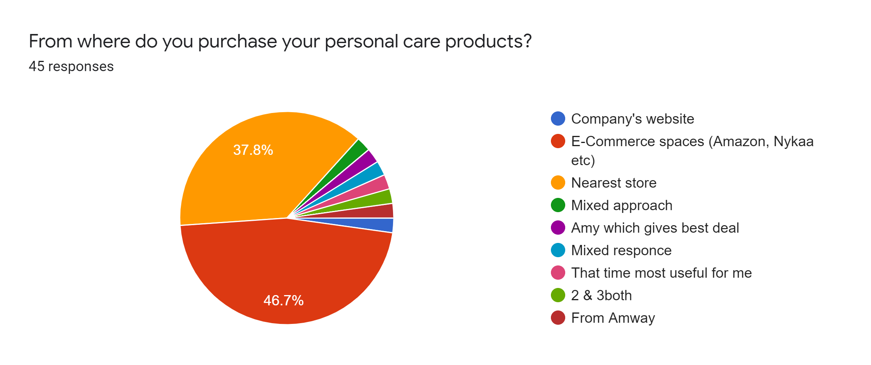
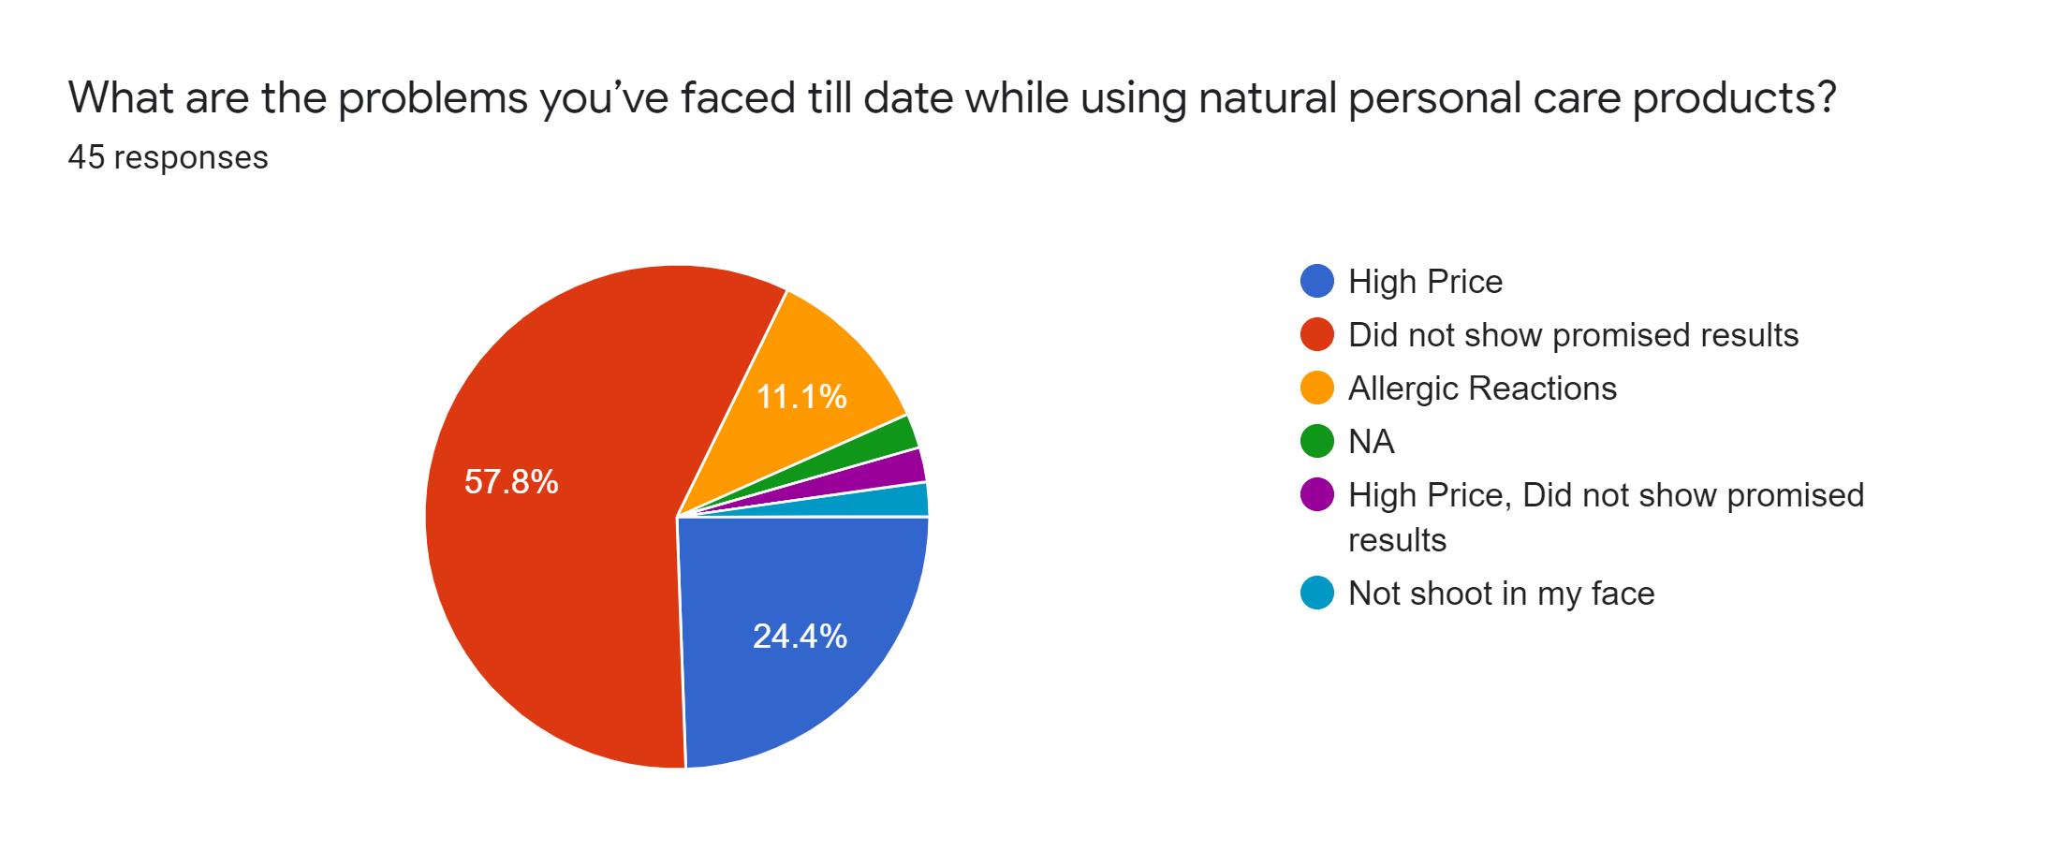
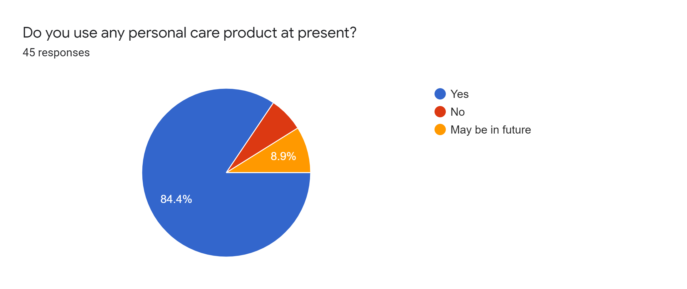
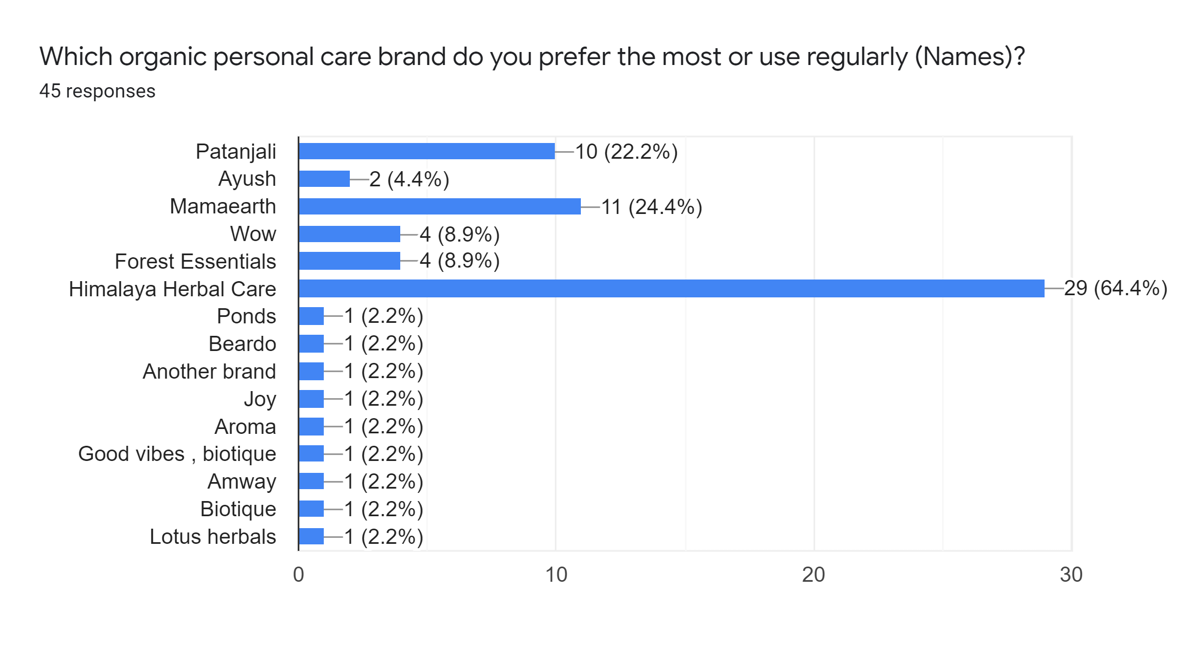
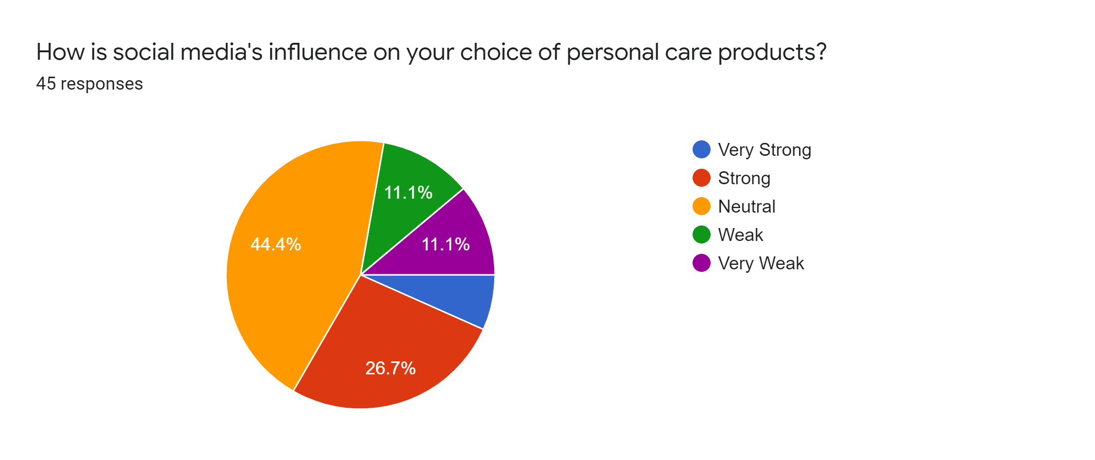
Primary Research: Key Highlights

Slide 6
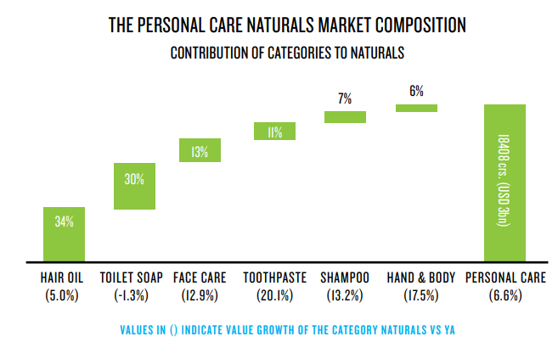
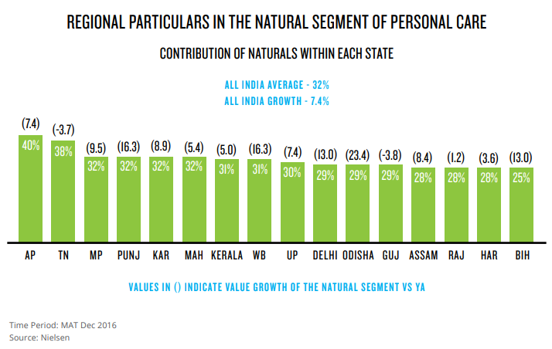
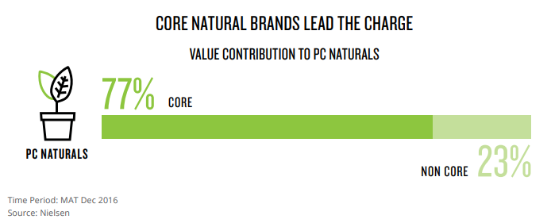
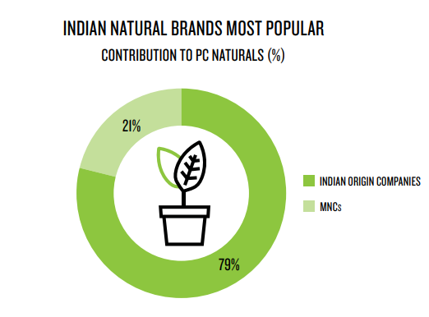
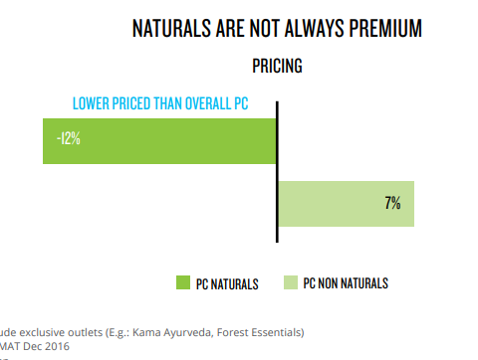
Secondary Research
01
02
05
03
04

Slide 7
Market Landscape
MARKET VOLUME
KEY TRENDS
The India beauty and personal care industry attained a value of INR 54,550 Crore in 2020.
The value growth of the natural segment is racing ahead at almost 2.2 times that of non-naturals (2.9%).
MARKET DRIVERS
MARKET SHARE
Improving quality of life, the positive effects of beauty and personal care on self-esteem and social interaction, and the gradual consumer shift towards premium and luxury cosmetic brands are expected to be the key drivers of the market.
The Natural segment in India’s personal care market is estimated to be INR 22,360 Crore, which is 41% of the total personal care market.
FORECAST
CUSTOMERS’ PERSPECTIVE
Expected to grow at a CAGR of 12% from 2021-2026.
.
Consumers are now seeking solutions from brands that are both safe for them as well as for the environment. They want products that are devoid of harmful chemicals and side-effects.

Slide 8









Competitors
.
1
5
2
3
4
.
6
7
8
9

Slide 9
SWOT Analysis
Strengths
Weaknesses
Product Quality and Product Innovation
Reliable Suppliers
Proven Business Model
Investment In Technology & Innovation
Customer-centric Products
S
W
No Physical Outlets
Low Budget For Marketing
Narrow Social Media Presence
Lack of Waste Management Policies
SWOT
Opportunities
Threats
O
T
New Environmental Policies
Lack Of Sachets In Organic Products
Positive Customer Sentiments Towards Eco-Friendly Alternatives
Operational Difficulties Due To Lockdown
Changing Regulatory Frameworks
Multiple Large, Established Competitors
Rise In Inflation

Slide 10
Target Audience
Demographic
Psychographic Segmentation
Knowledge
Traits
Geographic Segmentation
Behavioural Segmentation
Budget
Age
14-20
21-25
26-32
<500
500-2000
Sex
Male
Female
Aware
Unaware
Confused
Environment Friendly
Don’t care attitude
Developed Region
Developing Region
Underdeveloped Region
Purchasing Factor
Price
Brand Name
Ingredients used
Priority
Skin Care
Hair Care
Segmentation
Dominant Traits
*Created from the data received from market research

Slide 11


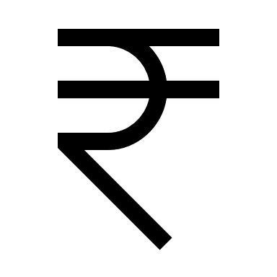








Targeting Positioning
Female aged between 21-25
Unique in the market
Budget-friendly products
Most environment-friendly in the market
Creating more awareness about personal care
The Brand for all
Environment-friendly products and packaging
Pocket-friendly
Developing and underdeveloped regions
Let’s say if someone is looking for a personal care brand that is unique with its products as well as environment-friendly, made for everyone and the most cost effective, then it should be ‘BU’.
Best quality ingredients
Skin care products

Slide 12
Roadmap For The Next 1 Year
Here we are working on our Re-branding to position ourself in the competition
Here we are working on taking customer feedback and implementing them
And utimately we’re all set to achieve our goal to serve people to the fullest
Here we’re working on maximizing the SALE
.
Not going with the flow, here we are avoiding the DON’Ts and the barriers
Here we are analyzing the market trends and working on the DOs
Text Here
Download this awesome diagram.
Here we are learning from our past mistakes and working on them

Slide 13




Re-branding : Logo, Tagline, Vision and Mission
Our new logo
Tagline
Vision
Mission
Our new logo depicts our core message i.e to add values to the lives of people and bring a smile on their face.
Personal Care and You
Our new tagline consists of two things that we care a lot about – Your Personal Care & You.
Personal Care for a beautiful & healthy life.
To become a personal care friend and add value to the lives of people.

Slide 14
Our Re-Branding HERO
What do we mean by re-branding hero ?
Packaging
Modifications
Influencer
Marketing
P
A story without a hero ?
Eww ! DULL.
A story with a hero playing 5 different roles ?
Woaah ! FANTASTIC.
Our re-branding hero VISPT is on a mission to lead the brand’s goal to new heights, portraying 5 different roles and hence the name.
I
Travelling
Toolkit
Value
Addition
T
Sachet
Production
V
S

Slide 15
V – Value Addition
Source Of This Idea
Our Planning
Value Addition: Our market research indicates the fact that people believe a brand should also care about the environment and focus on sustainability.
So, Value addition is a must for us to be there in the market for a Long Run and emerge out from the heavy competition.
Plan
To add value to the lives of people via not so sale-friendly social media channels
Demand
85% of the customer base believes that brands should focus on providing value rather than hardcore selling
Problems We May Face
Low visibility of our social concerns
People believe a brand also has some social responsibilities
All the market players are focusing only on sale through every channel
People generally don’t buy from certain social media channels and we’re focusing to add values through those mediums
Solutions Planned
We’ll promote our social concerns too along with our products. (Ex: Focus on Vegan products)
Benefits
It will build trust and help us to sustain in the market for a long run
Re-Branding Highlight:
Social Responsibility is the key highlight of our Value addition idea. We’re focusing to build our social media reach on less sale driving social media like YouTube and Pinterest to educate our customers about benefits of natural products, sustainability, our social causes etc. We strongly believe that it will build Trust among them and they will be added to our loyal customer list.

Slide 16
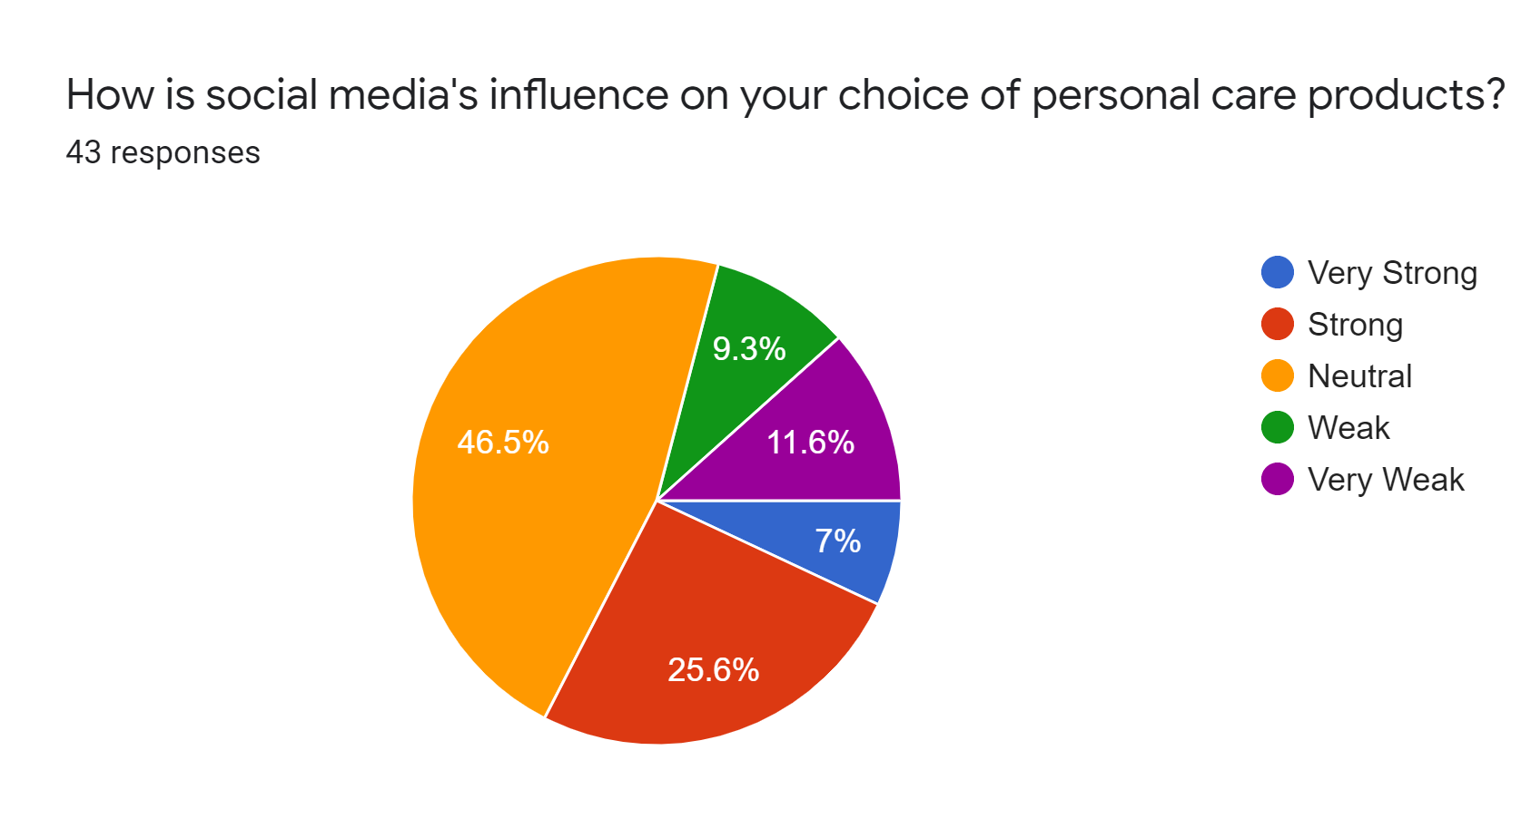
I – Influencer Marketing
Source Of This Idea
Our Planning
COVID-19 induced Lockdown brought a new wave of online boom. Nearly everything is shifted online and people are investing most of their time on the internet. This clearly indicates the fact that strong social media presence is the need of the hour and for that Influencer Marketing can serve the best with the growing number of influencers on Instagram, YouTube and other video content apps.
Plan
To drive the tech savvy customers from social media through influencer marketing
Demand
Huge online presence of potential customers & their growing consciousness towards personal care
Problems We May Face
Huge competition
Nielsen studies show that home-bound consumers have led to a 60% increase in the amount of video content watched globally
Influencer marketing is emerging as one of the driving forces behind the rise of personal care sector in India
Influencer marketing brings a broader reach if the campaign hits on point
Solutions Planned
Unique Ad Campaigns, Problem solving products & strong influencers promoting them
Benefits
Firm online presence and exponential growth
Re-Branding Highlight:
Influencer Marketing campaigns had a significant positive impact in terms of product awareness, consumer engagement, product sales, and revenue.
Our Focus is on choosing the right influencers whose presence go hand-in-hand with our brand image and values to drive our targeted audience.

Slide 17
S – Sachet Production
Source Of This Idea
Our Planning
Experiment: Our primary research indicates the fact that people are not willing to invest in a new brand unless there are trusted results.
So, we came up with this idea of introducing Sachets into the market as a mode of trial.
Plan
To be used as a mode of trial, to distribute in hotels, low income sectors and rural areas.
Demand
60% of the market want to invest in a new brand if there are trusted results
Problems We May Face
Lack of distribution channels, lesser sale in the beginning
People want to try before investing
Expanding our reach to low income zones
Our Collaboration with hotels
Popularizing the brand name
Solutions Planned
Collaboration with a distribution channel, Promotion of Sachets through hotels
Benefits
It will build trust, drive potential buyers and expand the reach to maximum customers
Re-Branding Highlight:
Collaboration and Experimenting is the key highlight of our Sachet production idea. The major barrier on our way was a broad nation-wide distribution and our operational partner MRational has taken this responsibility to work with us to distribute these sachets to local retail shops, hotels, airlines etc.

Slide 18


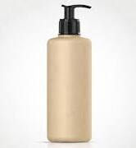


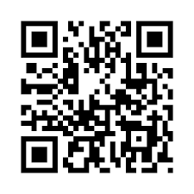
P – Packaging
Source Of This Idea
Our Planning
Carton-free version A
Paper Bottle B
Got rid of outer box packaging. Just bottles. Less packaging material used means less waste.
.
Outer part is made up of paperboard and inner part with recyclable plastic, providing it the necessary strength.
Increasing awareness towards sustainability
Increased focus of companies towards circular ecosystem
Added impetus on Reduce, Reuse and Recycle
Packaging Trivia
Key Highlights
It's estimated that more than 120 billion units of packaging are produced by the global cosmetics industry every year.
TEXT
Minimalistic Packaging Using Recyclable, Reusable And Compostable Materials
.
Metal-Free Pumper C
QR On Bottles D
Metal free pumper ensures everything is recyclable.
Every package will contain a QR code, which will lead to the links of our social media handles, which will demonstrate our eco-friendly initiatives.

Slide 19
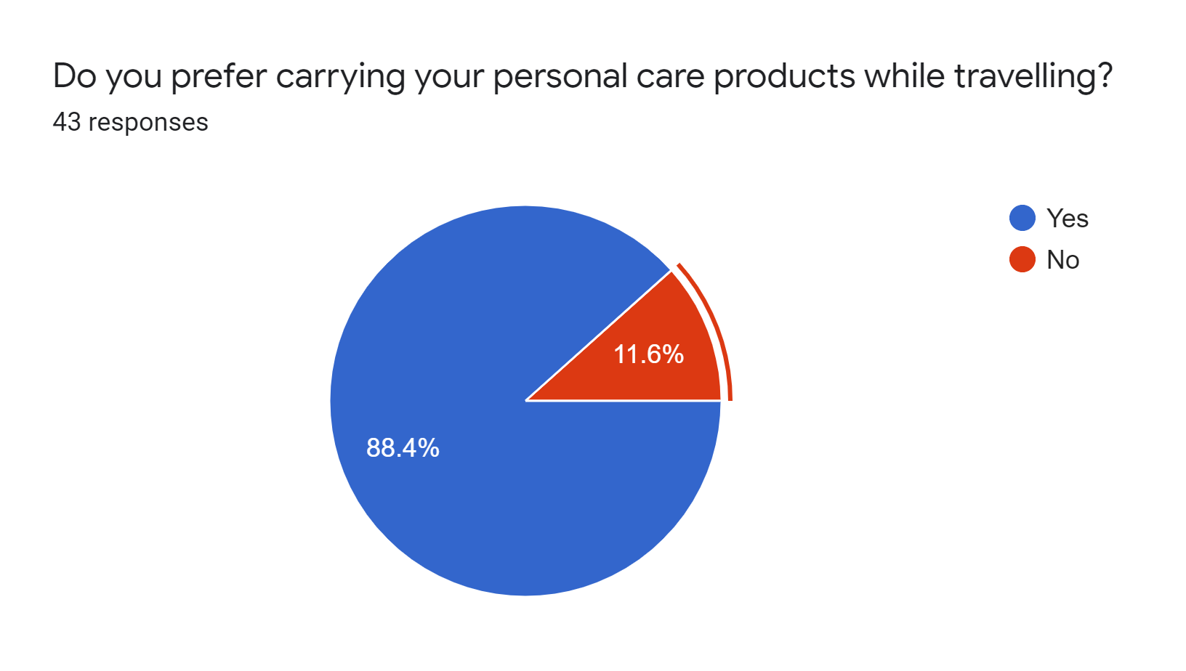
T – Travelling Kit
Source Of This Idea
Our Planning
In our Primary Research, we asked people if they prefer to carry their personal care products while travelling and to our surprise 88.4% of them voted for YES and that’s where came the idea of launching a Mini Travelling Kit in our Re-Branding campaign.
Plan
To launch something in the market which is never done before, a Mini Travelling Kit
Demand
88.4% of the people in our primary research preferred to carry their personal care products
Problems We May Face
Slow acceptance by the potential buyers
Personal care products becoming the daily need
But still most of the Indians carry a pouch/bag with all their big to small personal care essentials which sometimes become hard to carry while travelling
According to our research, 6 out of 10 people often miss one or two essentials to include in the pouch/bag
Solutions Planned
To promote the kit via our collaborated hotels, travel agents, airlines and sachets
Benefits
Can create a WOW FACTOR in the market
Re-Branding Highlight:
Our Mini Travelling Kit is going to be an affordable and quick solution for the avid travellers. This kit will contain all the essentials and can be customized according to the number of travelling days and requirements.

Slide 20
Projection & The Road Ahead
The Global Reach
Our ultimate aim is to dive into the global market and as mentioned to be a GLOBAL Personal Care Giant in the coming years.
Streamlining things & Fund Raising
The experiment check is expected to take nearly 6 months and then we’ve forecasted to streamline every possible thing and target to raise funds for the future endeavors.
A year after the Re-Branding challenge
We’ve forecasted a boost in the sale as close as 250% of the current figures and the first workaround would be to analyze what went correct with the strategy and what did not.

Slide 21


Towards A Sustainable Future
Sustainability Goals
Environmental Protection
Eco-friendly packaging would produce less dent on the environment.
Carbon-neutral operations would maintain a healthy ecological balance.
The goal is to balance between consumption and generation of natural and social resources, including resource recovery.
Environmental
Bearable
Equitable
Sustainable
Economic Prosperity
Social Responsibility
Reducing operating costs by adjusting value chain to very low usage of resources.
Increasing efficiency of various processes by utilizing technology-driven solutions.
Sourcing of natural ingredients from local farmers and forest communities, thereby boosting rural economy.
Employee-centric and inclusive work culture would foster community growth.
Viable
Economic
Social

Slide 22
Conclusion
Reach
Reach
Low reach, only our social media followers knew about it
After Re-branding
Before Re-branding
Expecting High reach, huge word of mouth, rural expansion
Sale
Sale
Low Sale, sale was driven only after running expensive social media ads
Expecting 2.5x sale. Expected channels – Word of mouth, organic traffic, paid ads
Acceptance
Acceptance
Poor acceptance. People hardly accept any new brand in this market
Expecting moderate acceptance as we’re planning to provide great first experience and also trials via the Sachets introduction
Experience
Experience
We were new, we did not experience failures to learn from
Expecting a learning experience from the results of this re-branding strategy

Slide 23
References
https://startuptalky.com/dove-marketing-strategy-campaigns/
https://marqueex.com/the-winning-marketing-strategy-of-mamaearth/
https://magicpin.in/blog/natural-skincare-brands/
https://www.mordorintelligence.com/industry-reports/global-beauty-and-personal-care-products-market-industry
https://www.astuteanalytica.com/industry-report/personal-care-products-market
https://www.expertmarketresearch.com/reports/india-beauty-and-personal-care-market
Breakdown of the cosmetic market worldwide by product category, 2020 | Statista

Slide 24
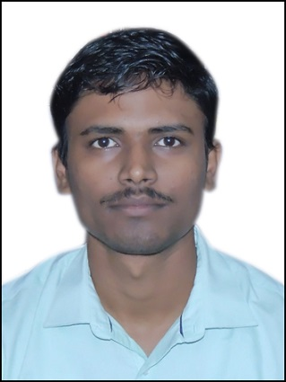


T E A M
Manish Shaw
MDI Gurgaon, PGDM IB Co’23
Mohit Kiradoo
TAPMI Core, PGDM Co’23

